Slide 1
The internet of things: in a wider urban context
Sam Austin - 000891017
Daniel Blake – 000888005
Usman basharat - 000874782

Slide 2

What is it?
It is the implementation of smart technologies within cities and homes.
Smarter homes
Smarter cities
Already being implemented in daily life

Slide 3
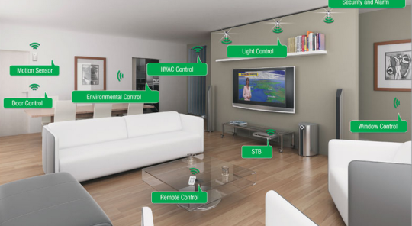
The future of this tech
Estimated that cities are going to spend an estimate of $41 Trillion on implementing the IoT into cities.
Sensors in environments
Increased security
Energy conservation
Waste
Commuting
Parking
http://datasmart.ash.harvard.edu/news/article/the-urban-internet-of-things-727

Slide 4
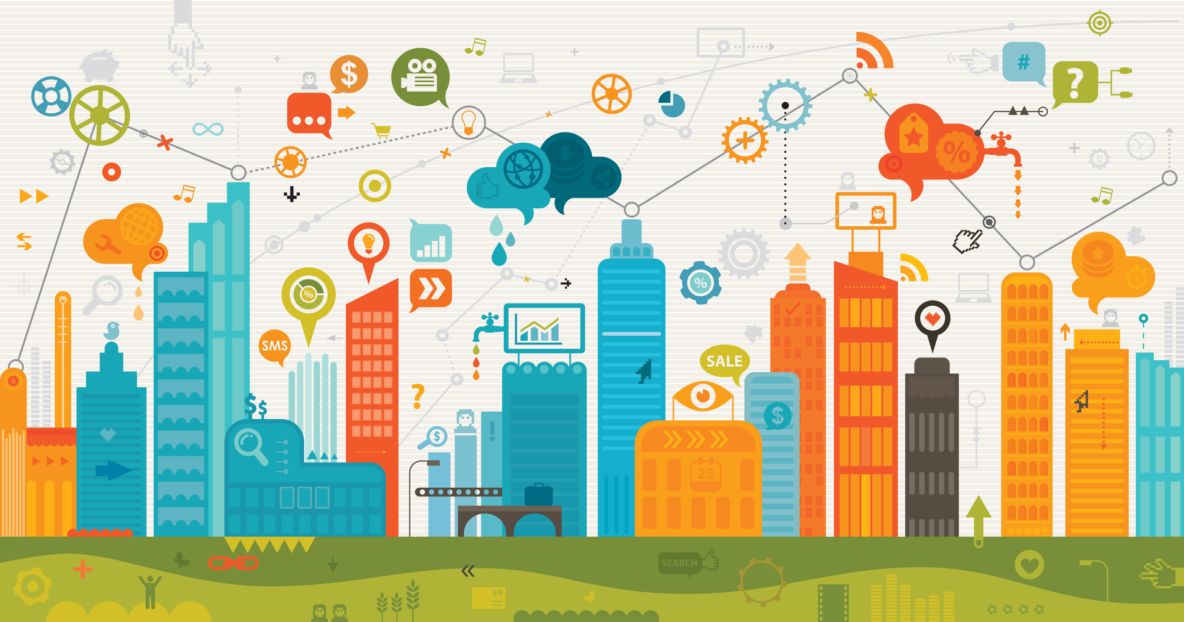
Benefits of the IoT (Internet of things)
Increased productivity
Safer cities e.g. tension in bridges, road conditions
Energy saving
Even Water distribution
Things become quicker with automation

Slide 5
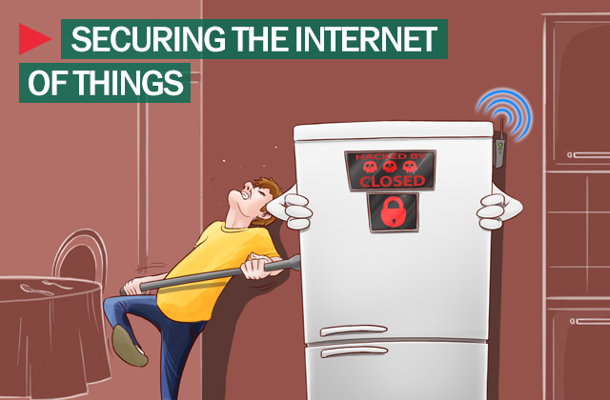
Ethics
Laziness
Safety
Security

Slide 6
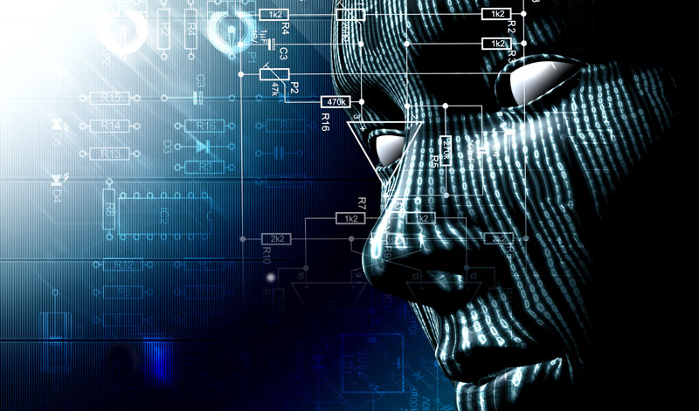
Security issues and contingencies
Can anyone see any potential security flaws with the internet of things?
Hackers infiltrating the technology and gathering personal data
Privacy issues within home lives
Smart criminals can figure out your routine
“ On average Internet of Thing device has 25 security flaws.” – The Telegraph

Slide 7

Security continued
As with all tech, security issues arise
Money easily stolen through NFC/RFID tags
Possibility of unsafe money transfers
A lot of details stored on cloud
Data needs to be secure
Encrypted

Slide 8

What do we think?

Slide 9

Are there any Questions?

